Slide 1
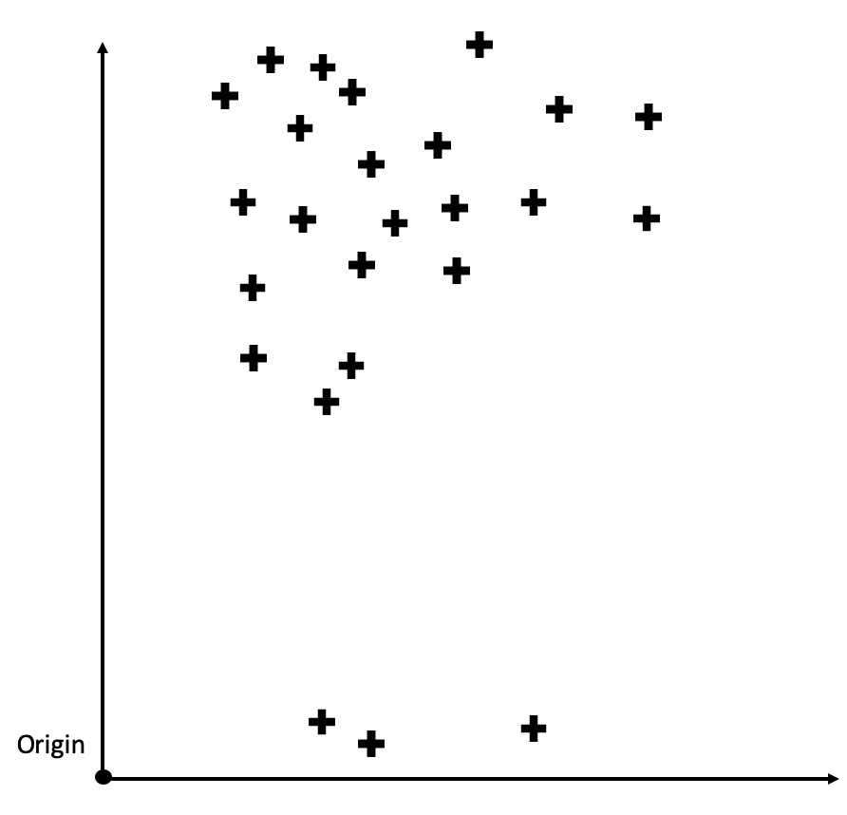
Parts (a) and (h)
Instructions:
Move the shapes below to the correct positions on the plot to the left.
Decision boundary
Parallel hyperplane whose distance from the decision boundary is the margin
Margin
Data points whose dual variables are non-zero

Slide 2
Parts (a) and (h)
Instructions:
Move the shapes below to the correct positions on the plot to the left.
Decision boundary
Parallel hyperplane whose distance from the decision boundary is the margin
Margin
Data points whose dual variables are non-zero

Slide 3
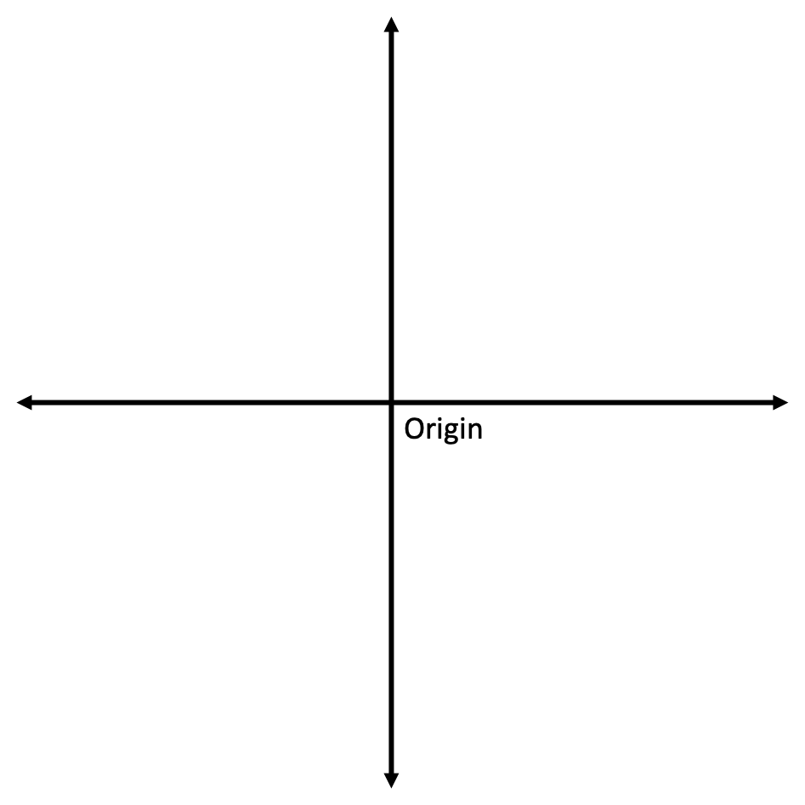
Part (e)
Instructions:
Move the shapes below to the correct positions on the plot to the left.
Training data points

